Slide 1
Tic Tac Toe In TTL
This is a human versus TTL circuit version of Tic Tac Toe, but with no
CPU. It's all plain old digital logic.

Slide 2
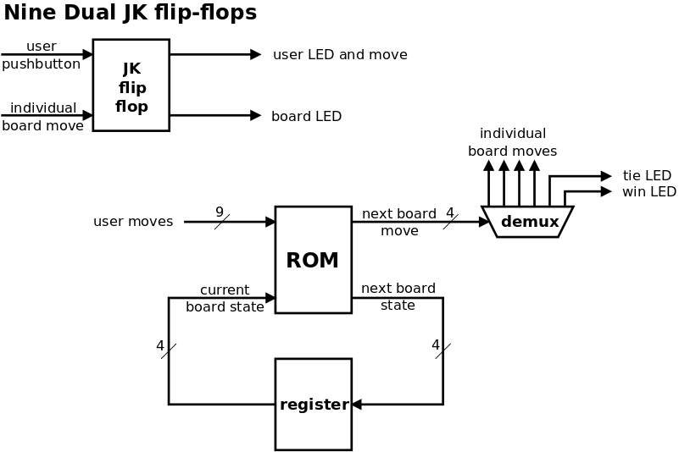

Slide 3
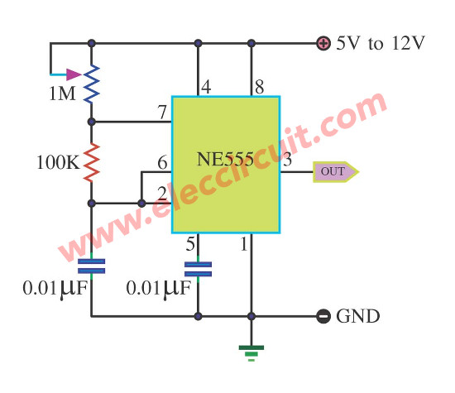

Slide 4
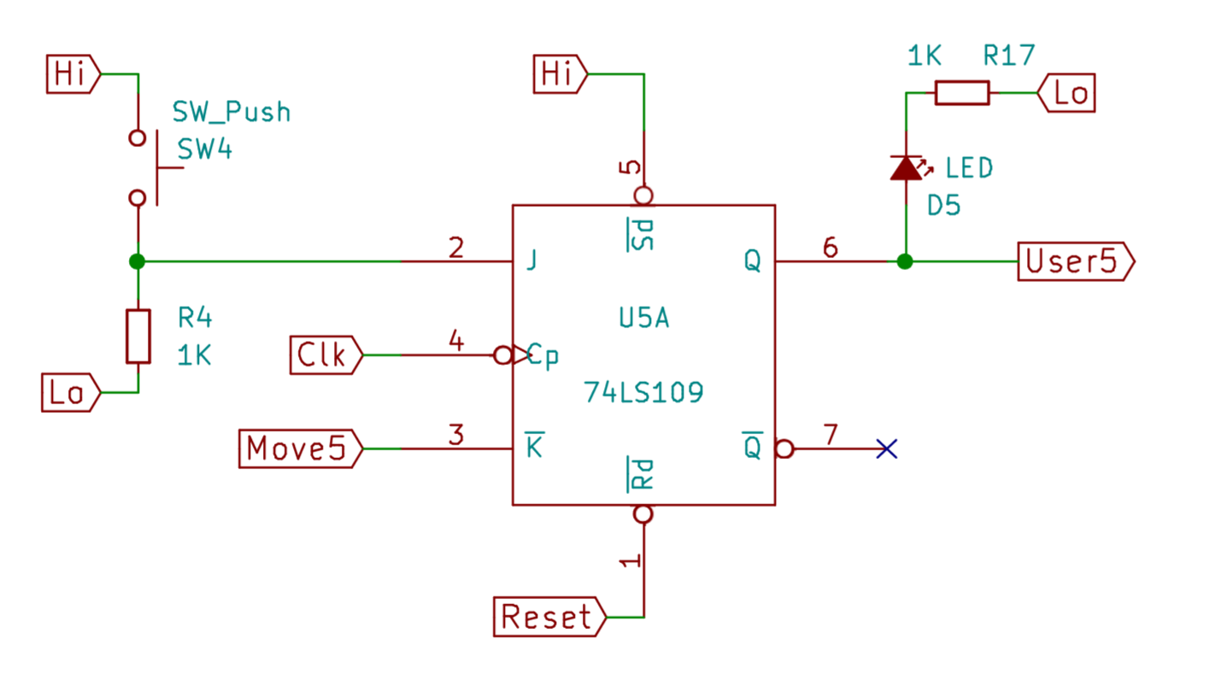

Slide 5
